Slide 1
Code Caves
What they are and how to use them

Slide 2
What is a code cave?
Blank memory area in the .TEXT segment
.TEXT segment is Executable region
Therefore any code injected here will execute

Slide 3
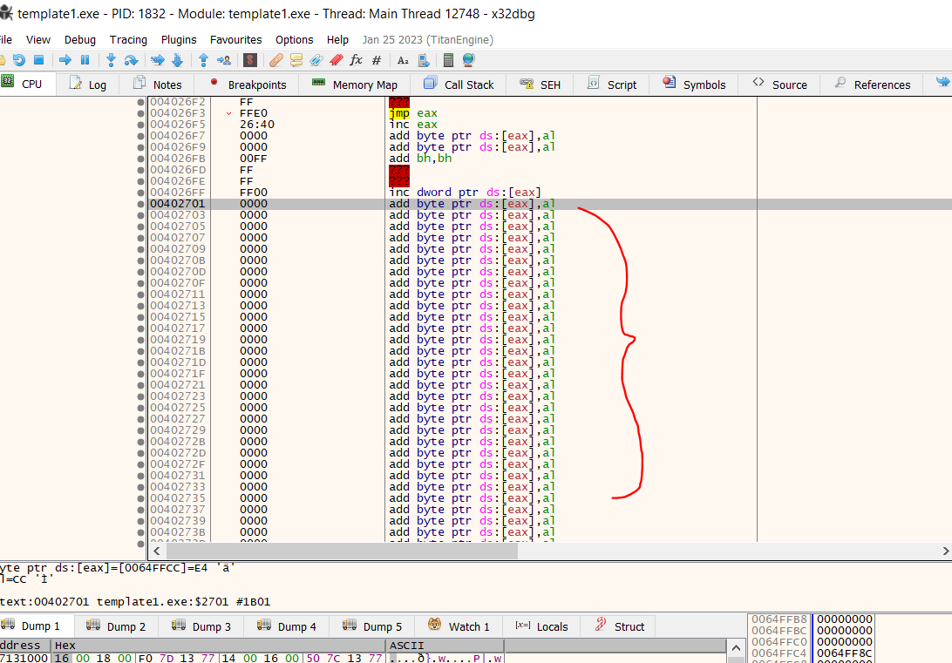
Scroll down to bottom of the .TEXT segment:
Code Cave

Slide 4
Why use a code cave?
. . .
. . .
. . .
jump to code cave
. . .
. . .
Jump Point
Run out of space to write code
So, jump to code cave to inject more code
Then jump back to after jump point
. . .
. . .
. . .
. . .
. . .
. . .
. . .
jmp back

