Slide 1
Flags Registers

Slide 2
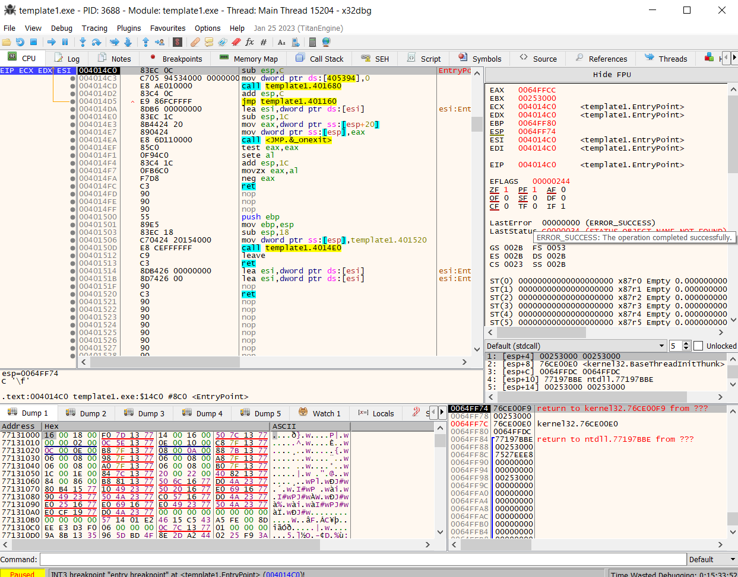
FLAGS Register
CF = Carry Flag
ZF = Zero Flag
SF = Sign Flag
OF = Overflow Flag

Slide 3
ZF (The Zero Flag)
ZF is set to 1 when the last calculation results in zero
ZF is cleared to 0 when the last calculation results in non-zero
For Example:
  mov eax, 0x8
  mov ecx, 0x8
  sub eax, ecx
After the sub instruction, ZF is set to 1

Slide 4
Another example:
  mov eax, 0x6
  mov ecx, 0x6
  add eax, ecx
After the add instruction, ZF will be cleared to 0

Slide 5
SF (The Sign Flag)
SF equals the most significant bit of the last calculation
Used in Two’s Complement Number Representation
  SF = 0 means positive
  SF = 1 means negative
For Example:
  mov edx, 0
  dec edx
SF = 1, because edx = 0xFFFFFFFF = 1111.........1111
Most Significant bit = 1

Slide 6
Another Example:
  mov edx, 0
  inc edx
SF = 0, because edx = 0x00000001 = 0000.........0001
Most Significant bit = 0

Slide 7
CF (The Carry Flag)
CF = 1 if the addition of two numbers causes a carry out of the most significant bit. A wrap-around has occurred.
Example:
  mov eax, 0xFFFFFFFF
  add eax, 0x1
eax = 0
CF = 1
Means the result you get from the addition is wrong

Slide 8
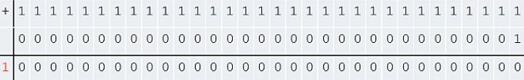
  mov eax, 0xFFFFFFFF
  add eax, 0x1
  CF

Slide 9
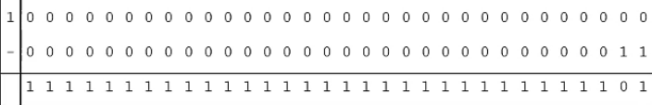
The CF will also be set to 1 if a subtraction requires a borrow from the most significant bit. A wrap-around also occurs.
example:
  mov ecx, 0x0
  mov edx, 0x3
  sub ecx, edx
ecx = 0xFFFFFFFD
CF = 1
  CF

Slide 10
The CF will be cleared to 0 if no Carry occurs. No wrap-arounds.
example:
  mov eax, 0x2
  mov ecx, 0x8
  add eax, ecx
eax = 0xA
CF = 0

Slide 11
OF (The Overflow Flag)
If we assume the numbers are two complements representation (signed numbers), then
the OF is set to 1 if:
  the addition of two positive numbers -> negative result
  the addition of two negative numbers -> positive result
  positive – negative -> negative result
  negative – positive -> positive result
If the OF = 1, it means the result you get from the calculation is wrong

Slide 12
another example:
  mov eax, 0x7FFFFFFF
  mov edx, 0x1
  add eax, edx
eax = 0x80000000
OF = 1
0000 0000 0000 0000 0000 0000 0000 0001

Slide 13
another example:
  mov eax, 0x7FFFFFFF
  mov edx, 0x1
  sub eax, edx
eax = 0x7FFFFFFE
OF = 0
0000 0000 0000 0000 0000 0000 0000 0001

