Slide 1
DIV (Divide) Instructions

Slide 2
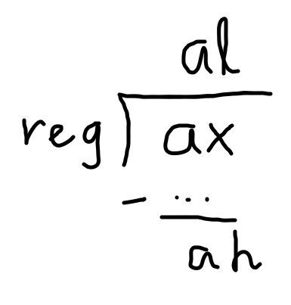
Examples of DIV (byte reg)
Quotient
DIV register
al ← ax / register
ah ←ax % register
Remainder

Slide 3
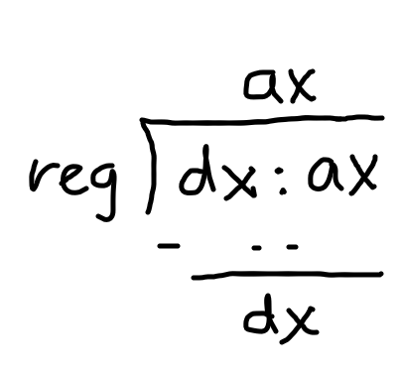
Examples of DIV (word reg)
Quotient
ax ← dx:ax / register
dx ←dx:ax % register
Remainder

Slide 4
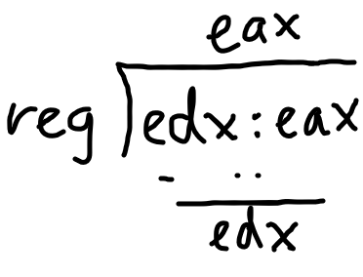
Examples of DIV (dword reg)
Quotient
eax ← edx:eax / register
edx ← edx:eax % register
Remainder

Slide 5
More Examples of DIV
div ch
al ← ax / ch (quotient)
ah ← ax % ch (remainder)
div esi
eax ← edx:eax / esi (quotient)
edx ← edx:eax % esi (remainder)
div di
ax ← dx:ax / di (quotient)
dx ← dx:ax % di (remainder)
div 0x8C
invalid

Slide 6

Exceptions
division by 0
eg mov eax, 0x3
mov edx, 0x0
mov ecx, 0x0
div ecx
quotient overflow – if quotient is too large
eg mov eax, 0x00005678
mov edx, 0xFFFFFFFF
mov ecx, 0x2
div ecx

Slide 7
DIV exercise 1
mov ecx, 0x2
mov edx, 0x0
mov eax, 0x8
div ecx
inc ecx
div ecx

Slide 8
DIV exercise 2
mov ebx, 0x3A
mov edx, 0x20
mov eax, 0x0
div ebx
div bx
mov bl, 0xFE
div bl

