Slide 1
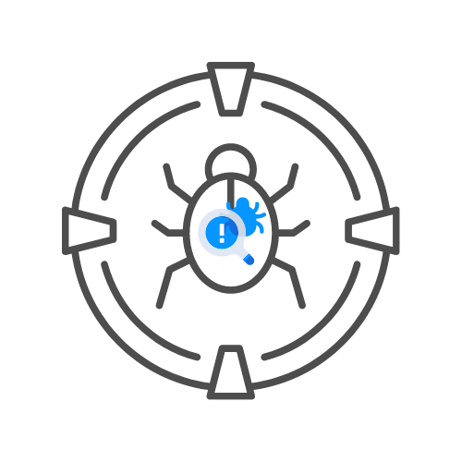
CNWPP – EXAM GUIDELINES
By Uncle RAT 🐀

Slide 2
Agenda
- Planning your exam
- Requirements
- Deliverables
- Technical issues
- Breaks
- Report sending guidelines

Slide 3
Planning your exam

Slide 4
Planning
- Mail preferred date + starting time + exam voucher code to info@thexssrat.com
- We will reply if date is confirmed + send over NDA to sign (read carefully and send back signed)
- At start time, 1 hour meeting max for scope definition
- Proctor will join you via discord call
- 8 hours time allotted to create test plan
- Request approval from proctor

Slide 5
Planning
- Approval will be
- Don’t start testing until you receive signed test plan
- 8h to test
- After 8, test env will go offline so gather evidence while testing
- 24h to complete report (not proctored) and send in + send in debriefing (powerpoint + video going over found issues)
- 5 workdays later max you will get feedback and hear if succeeded

Slide 6
Requirements

Slide 7
Requirements
- Documentation and process matter a lot
- You will need to hack a network (ports), API and website
- At least 70% of marks required to pass
- Not perse required to find all issues, that is even impossible
- Report EVERYTHING, this is a pentest, even informatives
- Ask questions during the exam, some things will be left out on purpose - NO VPN IS REQUIRED

Slide 8
Deliverables

Slide 9
Deliverables
- NDA, Signed and dated
- Test plan, signed and dated
- Test report, signed and dated
- Debriefing video and powerpoint

Slide 10
Technical issues

Slide 11
Technical issues
- Upon serious technical issues (Discrection of proctor)
– Exam may be paused
-- Exam may be postponed
-- Always contact poctor

Slide 12
Breaks

Slide 13
Breaks
- Required to inform proctor
- Encouraged to take breaks
- You can let automation run
- Exam is NOT paused

Slide 14
Report sending guidelines

Slide 15
Report guidelines
- Report has to be in a ZIP file with powerpoint and video debriefing
- ZIP HAS TO BE PASSWORD PROTECTED
- PASSWORD HAS TO BE SHARED
- CHECK YOUR ZIP, WE ARE NOT RESPONSIBLE FOR CORRUPT FILES
- Email to: info@thexssrat.com
- Late reports will automatically disqualify you

