Slide 1
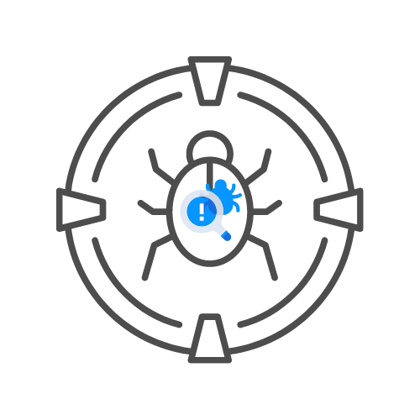
BURPSUITE 🤖
⌛ 20 min
DAY 04

