Slide 1
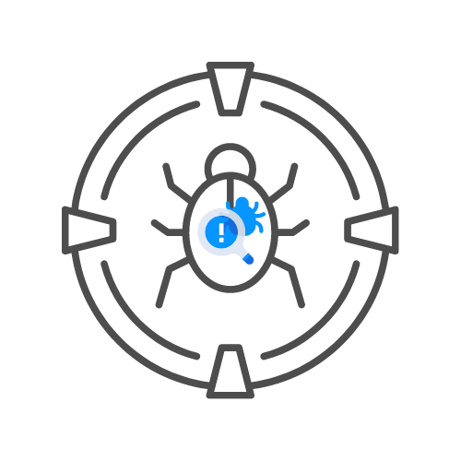
INSECURE DESERIALIZATION
⌛ 60 min
DAY 05

Slide 2
Agenda
Introduction
Serialization
Deserialization
Insecure deserialization
How does it occur?
How to identify it?
🚨PHP
🚨Ruby
So how do i exploit this?
🚨Functional testing
🚨Object injection
🚨What's next?
Resources

Slide 3
Introduction
Insecure deserialization is often seen as a very hard vulnerability type but it doesn't
have to be. It does require decent knowledge of the programming languages in question
but it can also occur very trivially if you have some knowledge of the programming
languages.
In this module we will be looking at PHP and Ruby deserialization processes by
practical examples on the portswigger labs. This will allow us to better understand the
concept.
Java serialization and deserialization use binary formats which are harder to read and
out of the scope of this document.

Slide 4
serialization
If we want to learn about deserialization processes we first need to learn about what
serialization is. When we talk about serialization, we are talking about the processing
complex structures such as objects (For example a person with an age,sex and name)
into a much flatter format so that it can be sent and received in a sequential stream of
bytes. This allows us to write complex data structures to memory, files or databases and
also to send that data over the network to different API's.
When we serialise data, we save it's attributes and their values, this is really important
to remember. Such as a female person of 16 years of age with the name "Sophie Kent"
will get turned into something like {female|16|Sophie|kent}

Slide 5
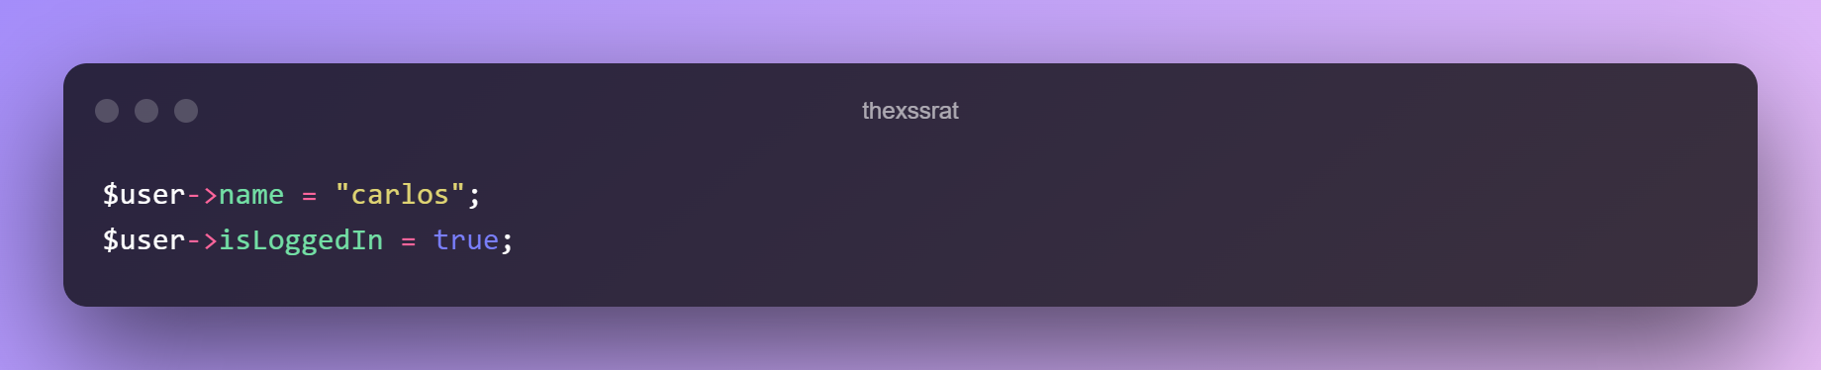
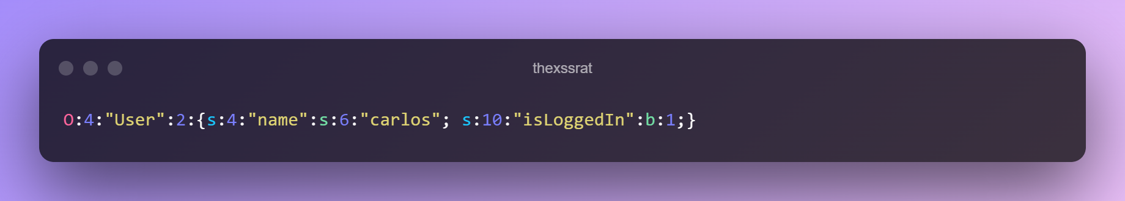
For example, consider a User object with the attributes in PHP:
When serialized, this object may look something like this:

Slide 6
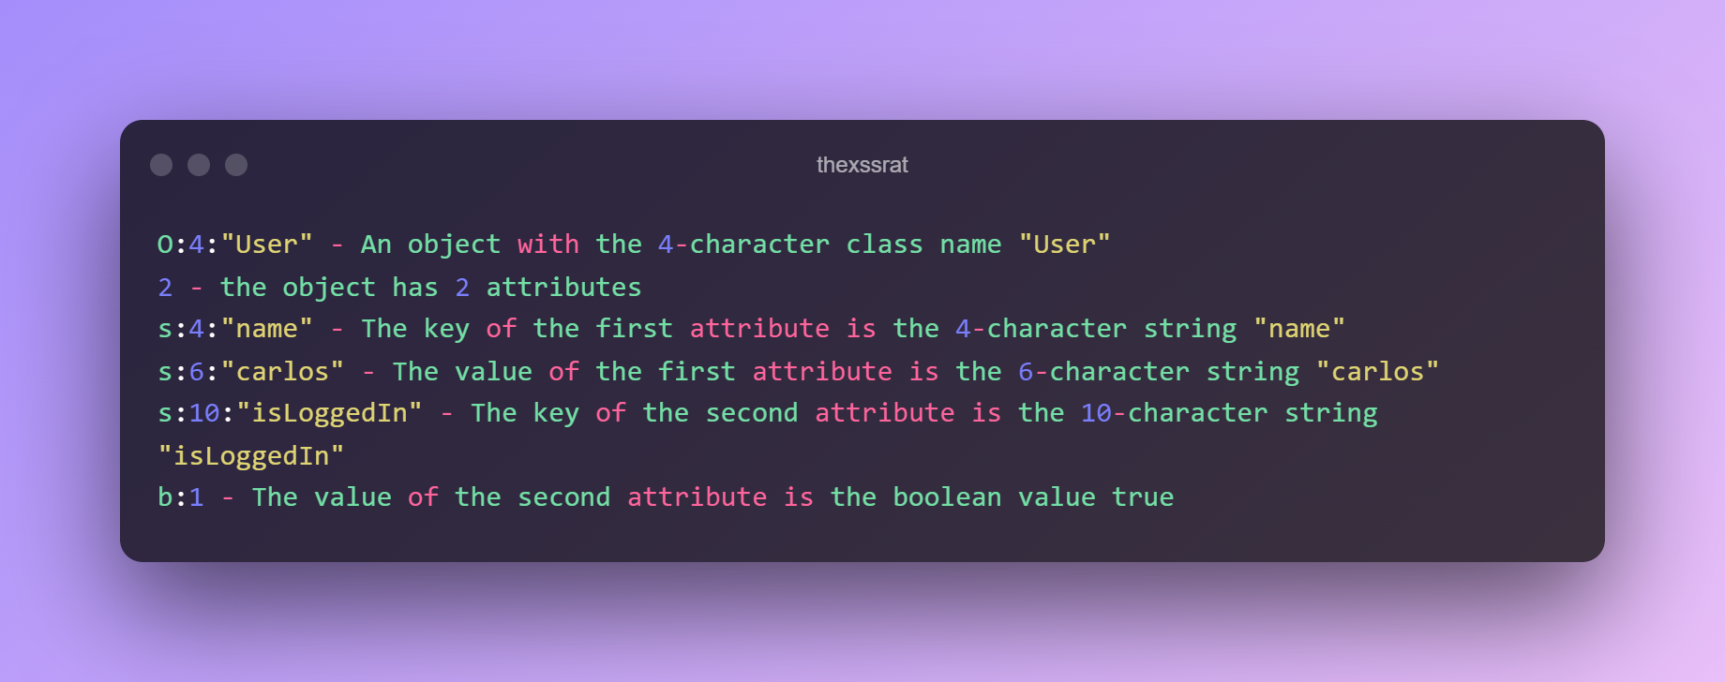
This can be interpreted as follows:
Python refers to serialization as pickling
Ruby refers to serialization as marshalling

Slide 7
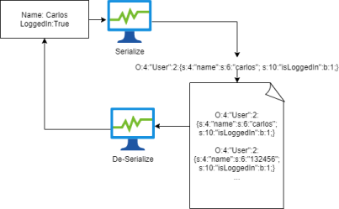
Deserialization
When we Deserialize we the opposite, we use the byte stream that was created and turn it back into an object. The avid hacker will have already spotted where this can go wrong.
How exactly the serialisation happens depends heavily on the programming language,
some might turn the objects into binary formats where others might use different string
formats. Some are easy to read, some are very hard to read.

Slide 8
Insecure deserialization
How does it occur?
Wherever user input is involved we have a potential for issues either now or later down
the line. In case of deserialization that time is right now. It is very hard to securely
serialize or deserialize user input properly because the developer will have to create
their own filtering and blacklists. If you think about it, modern websites have so many
dependencies and libraries that it's impossible to predict which methods an attacker can
invoke. If the attacker is really determined they will even chain different methods while
they pass data via sinks.
What's alarming about Insecure deserialization is that the attack occurs even before the
deserialization is complete. There is a general lack of understanding the whole
deserialization process and how dangerous it can be to Deserialise user input.
Even adding extra checks on the Deserialised data is going to be pretty ineffective as
the defect occurs before the deserialization process.

Slide 9
How does it occur?
Wherever user input is involved we have a potential for issues either now or later down
the line. In case of deserialization that time is right now. It is very hard to securely
serialize or deserialize user input properly because the developer will have to create
their own filtering and blacklists. If you think about it, modern websites have so many
dependencies and libraries that it's impossible to predict which methods an attacker can
invoke. If the attacker is really determined they will even chain different methods while
they pass data via sinks.
What's alarming about Insecure deserialization is that the attack occurs even before the
deserialization is complete. There is a general lack of understanding the whole
deserialization process and how dangerous it can be to Deserialise user input.
Even adding extra checks on the Deserialised data is going to be pretty ineffective as
the defect occurs before the deserialization process.

Slide 10
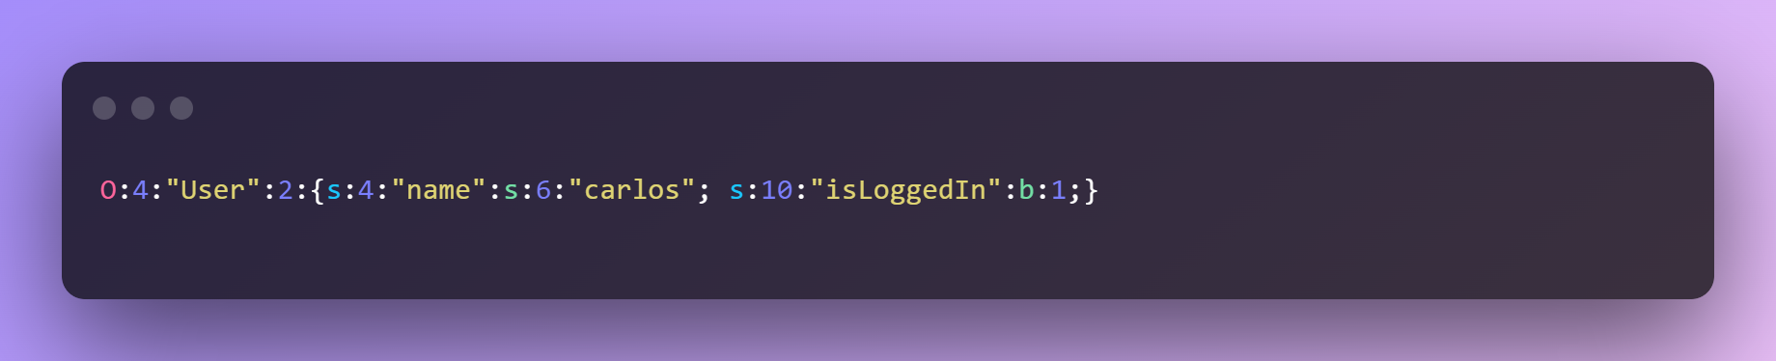
Ideally you should NEVER deserialise user input!
Because of the way this process works we can replace serialize objects with any object
the web application has access to. This is also the reason why Insecure deserialization
is sometimes refered to as object injection.
🎯How to identify it?
Identifying Insecure deserialization can usually be fairly straight forward to identify.
Different languages all use a specific format and if you know what it looks like it can be
easy to identify.
⚙️PHP

Slide 11
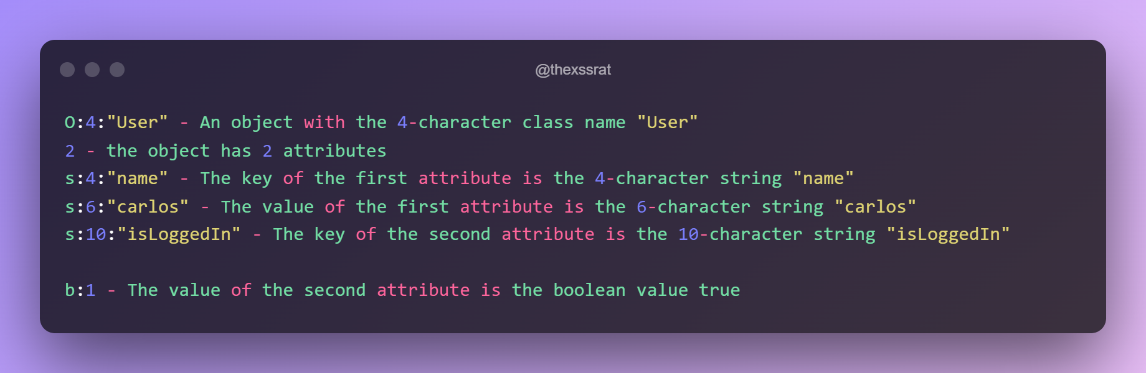
Ideally you should NEVER deserialise user input!
🎯We've already looked at this example before, PHP will serialize data in a mostly human readable format.

Slide 12
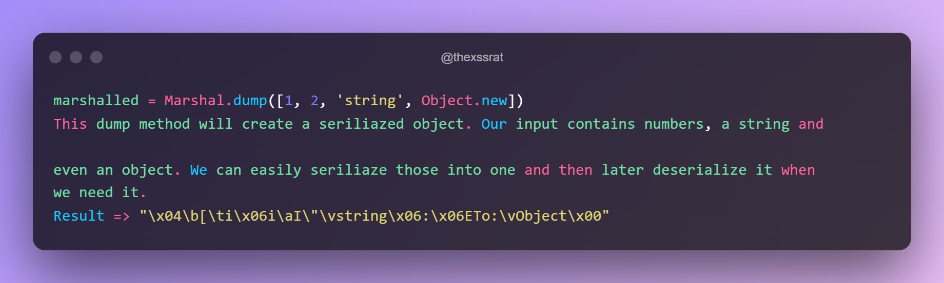
Ruby
📌As you can see Ruby seems to indicate it's "marshalled" data (remember that
marshalling is ruby's term for serialization) with hexadecimal notations (\x04).
What matters most if we encounter this is that we can create a very simple ruby script to
deserialize this object for us.

Slide 13
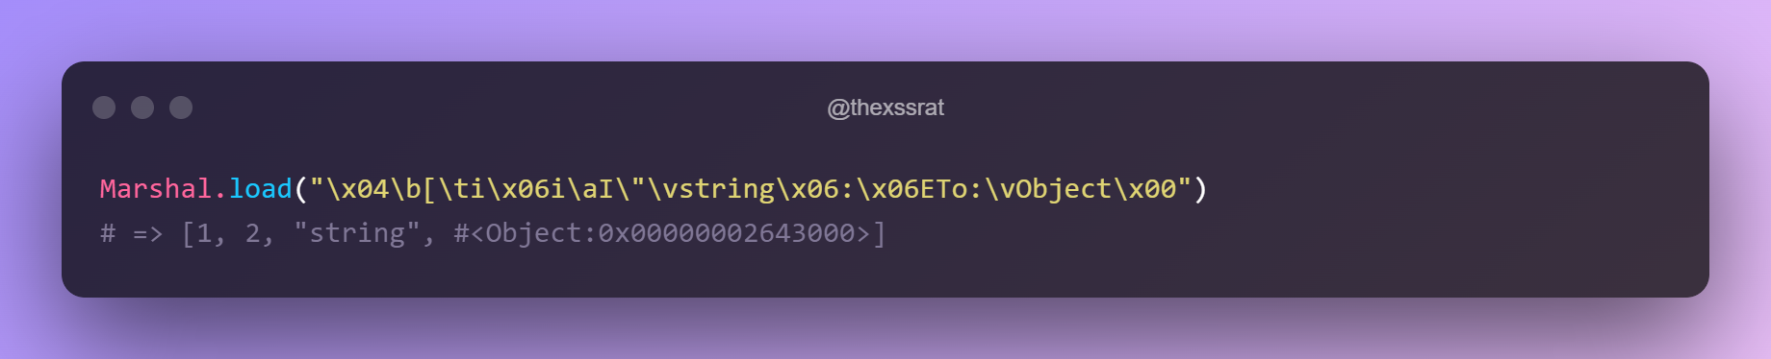
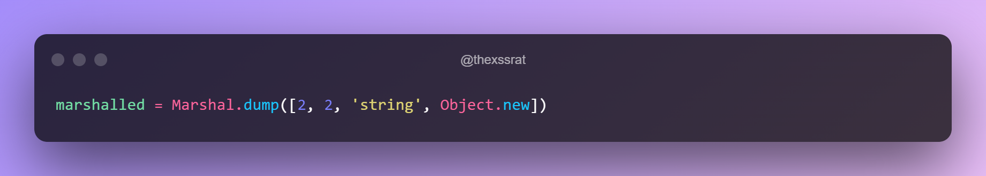
We can then make any changes we need to make and re-encode it with the marshal
dump method we saw earlier.

Slide 14
So how do i exploit this?
We can exploit this defect in two ways, I am mostly going to cover the functional way in
this document because that's how i hunt and object injection usually requires access to
the source code. I will also cover the object injection method to a certain degree so you
can become accustomed to it and i hope that you will look into it further if you are
interested in it.
⚒️Functional testing
When we are testing purely functionality we are relying on the fact that we might find
one of these serialized objects somewhere that we can manipulate the value.
Portswigger labs uses the cookies as an example but it can also occur in other locations
such as a hidden field in a form that might send a seriliazed object. Another location we
can find serliliazed objects is in the javascript code as it might need to pass on one of
those values to the back-end.

Slide 15
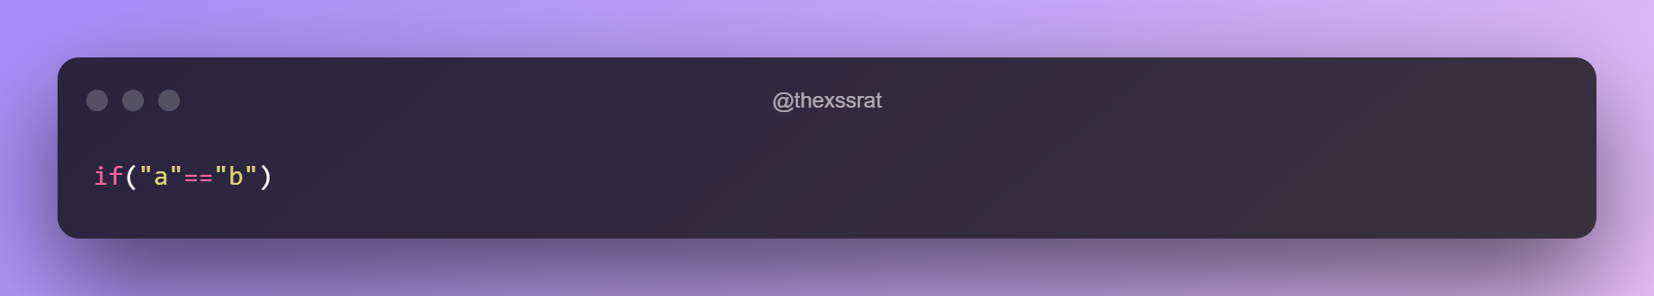
If we have a look at the portswigger labs we can see some easy PHP examples. All of
these rely on a cookie being set as a serialized PHP object. If you check the cookies
you should find something similar to our example. You can simply edit this cookie to do
things you should not be able to do. A basic example of this would be making yourself
admin by changing a boolean which you can find in the following lab:
https://portswigger.net/web-security/deserialization/exploiting/lab-deserialization-
modifying-serialized-objects
Programming languages like PHP have something that's known as loose comperison
operators. In PHP this is an example.

Slide 16
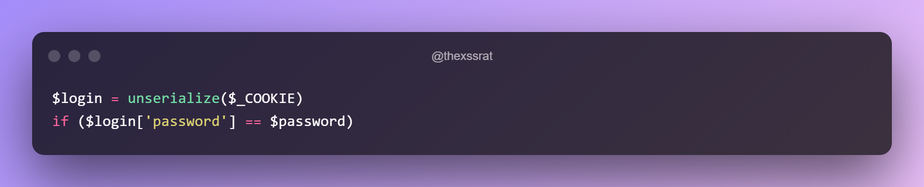
This == is called an operator and in this case two = signs means that PHP will check the
values of the provided variables but not the types. This means the following condition
would be true if the real password does not start with a number and we are able to
manipulate the password to be 0.
https://portswigger.net/web-security/deserialization/exploiting/lab-deserialization-
modifying-serialized-data-types
This last lab is actually very clever as it tries to get you to chain several vulnerabilities
together. You have to delete a file on the server which can be very destructive but
deleting that file is not so easy. After all, how are you going to delete a file on a
webserver you do not even own?

Slide 17
This lab also has serialized data in it's cookies and this time it allows you to set a user
avatar by providing a link. This does not seem very impactful as simply setting an avatar
does not cause much damage so let's move on.
A smart hacker however is thinking about what their possibilities are and they find out
that whenever they delete their account, the avatar picture also gets deleted by creating
a new account and trying to browse to his old avatar where they are greeted by a 404 -
not found message. This behaviour gives the hacker an idea, he will set the avatar's
location to the file he wants to delete and deletes the account. Suddenly they can't surf
the website anymore and they smile knowing they just deleted all the config files
https://portswigger.net/web-security/deserialization/exploiting/lab-deserialization-using-
Application-functionality-to-exploit-insecure-deserialization
All of these labs talk about PHP serialization and deserialization but of course all of
these attacks are also possible on any other language since they all revolve about
simply deserializing these objects ourselves while we make some changes and
serialialize the payload again (By looking up what commands to use in the language
manual and writing a simple script).

Slide 18
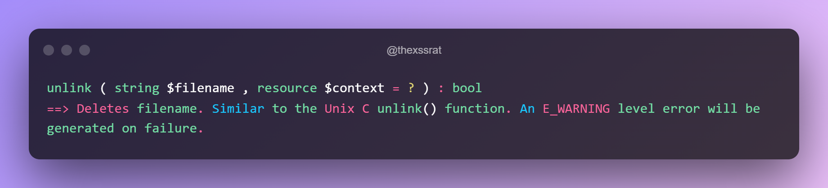
Object injection
https://portswigger.net/web-security/deserialization/exploiting/lab-deserialization-
arbitrary-object-injection-in-php
In this lab you will learn that you view the source code a file by entering the tilde sign
after the filename (~). This works because some editors and IDEs create backup files
which they mark with a tilde. Sometimes developers forget that they should never
upload these files.
When going through the source code we can find a __destruct() method that will invoke
the unlink() method on the lock_file_path attribute, which will delete the file on this path
according to PHPs manual.

Slide 19
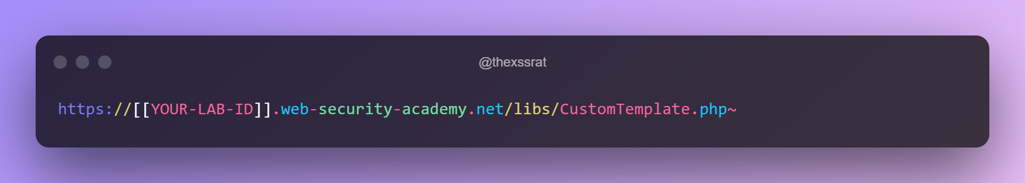
The website is making constant references to some CustomTemplate PHP site so let's
apply our tilde trick here.
this gives us a cool source code file with all of those methods we talked about. The
destruct method is a so called magic method which will be envoked when a serialized
object is destroyed which happens when we delete a serialized object.

Slide 20
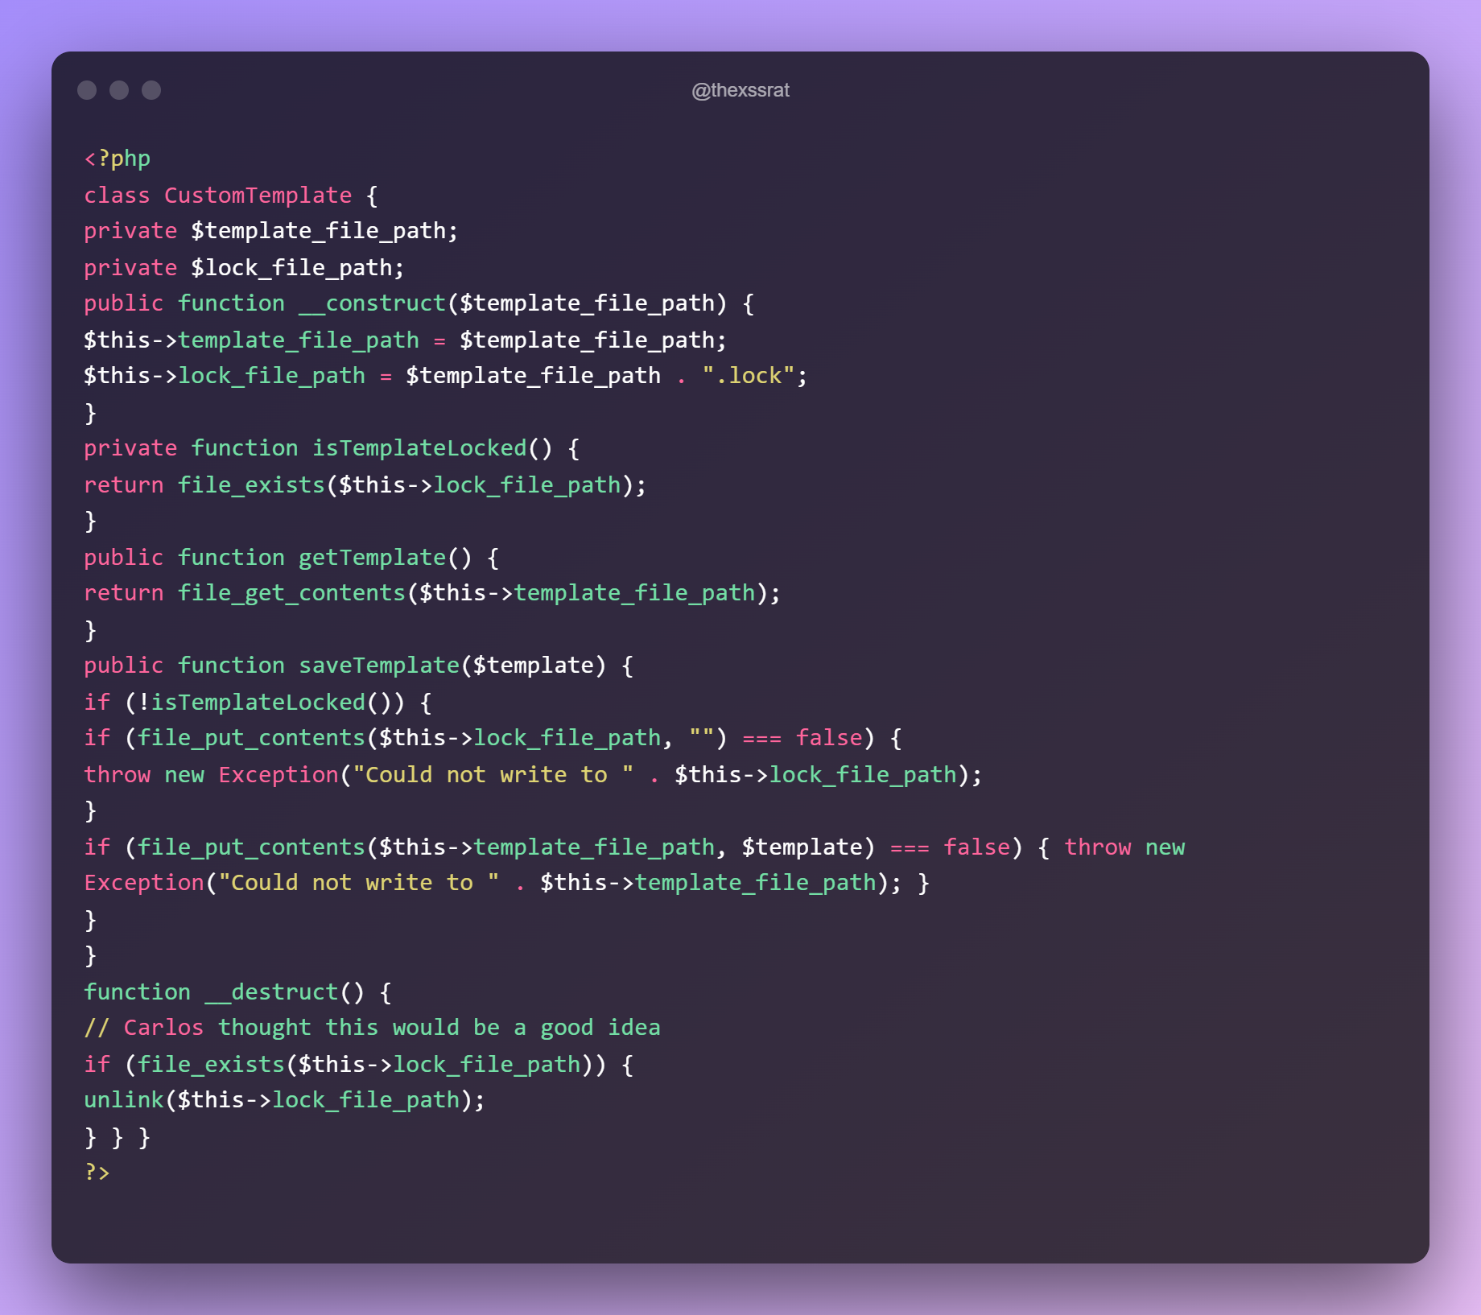
🧊📌With all of this information we are able to solve the labs. Since there is a serialized object in our cookies we can use that to construct a serialized object that contains the lock_file_path pointing towards a file we want to delete. If we now replace our session
cookie with the modified session cookie, the server will invoke the __destruct method automatically and destroy the file we were targeting.
🚨🚨NEVER DELETE IMPORTANT OR RANDOM FILES IN BUG BOUNTIES OR
PENTESTING!

Slide 21
What's next?
Of course object injection and functional testing are not the only two things we can do
here. You can also learn more about:
Binary insecure deserialization
Gadget chains
Creating your own exploit
PHAR deserialization
Deserialization using memory corruption

Slide 22
Resources💠
🎯https://stackoverflow.com/questions/410186/how-does-ruby-serialization-marshaling-work
🎯https://portswigger.net/web-security/deserialization/exploiting
🎯https://docs.python.org/3/library/pickle.html

