Slide 1
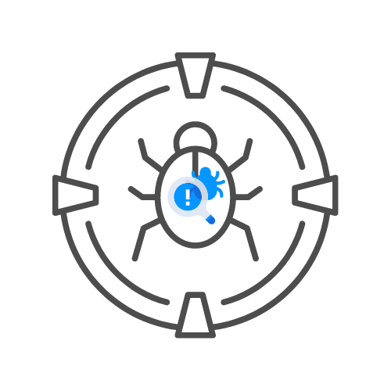
IDORs
⌛ 60 min
BY UNCLE RAT aka THE XSS RAT
DAY 05

Slide 2
Agenda
What is it?
Attack strategy
🧊Methods and tools
🧊Deep dive
First vs second order IDOR

Slide 3
WHAT IS IT ?

Slide 4
WHAT IS it?
IDOR= insecure direct object reference
Broken access control + Direct object reference
Made popular by the OWASP top 10
In reality, another type of broken access control issue

Slide 5
WHAT IS it?
Following must be true
🎯Identifier exists in request (ex. UserID=64)
🎯Broken access control issues exists
Example
🎯GET /invoice.php?id=12
🎯POST /personalInfo.php {personId:23,name:"tester"}
🎯GET /invoices/1234.txt

Slide 6
Attack strategy 🧑‍💻

Slide 7
Attack strategy – Methods and tools
Automated testing
🎯Burp match and replace
🎯Auto repeater plugin
🎯Authorize plugin
Manual testing
🎯Copy and paste URL
🎯Execute JavaScript in the developer console
🎯Replacing authentication headers in burp repeater

Slide 8
Attack strategy – deep dive
Webshop
🎯Test ALL the processes, including buying an item, returning an item, subscribing to a service,....
Game
🎯IDORs between users
Newspaper
🎯Subscription confirmations
Bank
🎯Test ALL the processes

Slide 9
Attack strategy
B2B application with same tenant policy
If you can't create sub-accounts
🎯IDORs between users of same tenant
🎯IDORs between tenant
If you can create sub-accounts
🎯Also test for IDORs between sub accounts
B2B application with non-same tenant policy
If you can't create sub-accounts
🎯IDORs between users of same tenant
If you can create sub-accounts
🎯Also test for IDORs between sub accounts

Slide 10
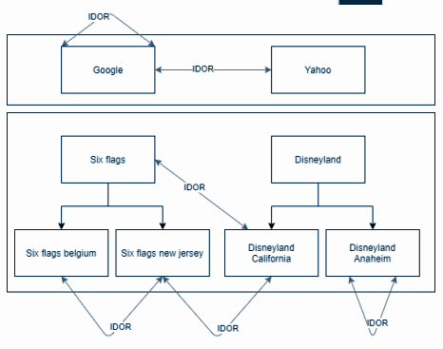
Attack strategy

Slide 11
First vs second order IDOR

Slide 12
First vs second order IDOR
Ex 1 GET to /receipt?id=4566 redirects to /succes if okay but to /error if unauthorised for call
🎯Make call to /receipt?id=4566 while not authorized
🎯Navigate to /succes instead of /error via burp intercept
🎯Get shown receipt that is not yours
Ex 2 Get /invoice?id=456 might not be possible
🎯Make POST call to /print/invoices with the id of the invoice
🎯Get shown the PDF you should not see
Ex 3 The user is not able to edit products that are not theirs
🎯Import product with the same name as the one you want to overwrite
🎯Overwrite the product info

