Slide 1
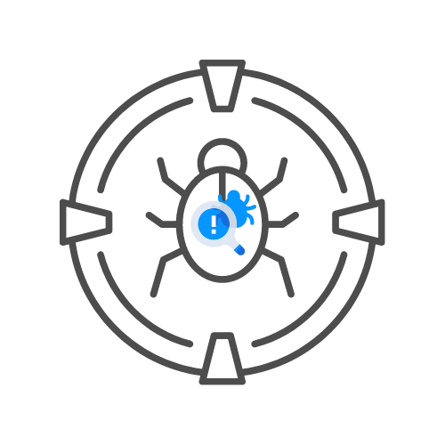
Active Directory Hacking Overview
⌛ 60 min
BY UNCLE RAT aka THE XSS RAT
DAY 05

Slide 2
Birdseye view
What is Active Directory
LDAP Attacks
NTLM Challenges and attacks and Pass the hash
SMB Signing
Kerberoasting Silver and Gold Tickets
Group Policy for persistence
Tools

Slide 3
What is Active Directory
Windows based management system
Microsoft directory service, allows for administration and management
Uses a forest and domain hierarchy
Has a wide range of features, including Group Policy for ease of domain wide management.
Compartmentalizes departments, users, security groups etc…
Wealth of information and the core of a windows network

Slide 4
LDAP Attacks
A protocol, used for directory services
Pass-back attack
Create a rogue LDAP Server to grab the LDAP credentials
Use OpenLDAP for this purpose
Edit the ldif file to accept plaintext

Slide 5
NTLM Challenges and attacks and Pass the hash
NTLM used by AD to authenticate identities
User Hashes are dumped from SAM or lsass, other methods.
Hashes can be bruteforced, or replayed or passed to impersonate the user
Actual Password is not necessarily needed

Slide 6
SMB Signing
Allows for client to server communication, network messaging, etc
Attack can be a rogue MITM attack relaying the SMB auth to get a session
SMB signing should not be enforced to have success
Tools to fit the job: Responder

Slide 7
Kerberoasting Silver and Gold Tickets
Kerberos is the auth service for windows domains and networks
Golden Tickets allow you to impersonate the krbtgt and dump the tgt for any user on the domain, giving you complete access, but its not discreet.
Silver Tickets are similar but are limited to a particular service, preferably one with admin access
Kerberoasting is grabbing a service ticket, and attempting to crack the service password from that ticket.
Tools for these attacks include: Impacket, Bloodhound, Mimikatz and others

Slide 8
Group Policy for persistence
Group policy allows for pushing standard settings throughout a domain, allowing for administrators to set rules and policies applied group wide.
If group policy access is gained, it can be used to make backdoors, lessen security, etc.
Understanding of how GP works is key

